Slide 1
React Pt 2
Aris Markogiannakis

Slide 2
Today's class
This week we will learn about:
Fetching data in ReactJS
React component lifecycle
Revise what we learnt in previous lectures

Slide 3

Create React App
We will download the Create-React-App, it is a boilerplate where we can start coding fast without the need of setting up webpack, babel as it is already done for us.
To do so we will need to run the following command on our terminal
> npx create-react-app my-app
> cd my-app
> npm start

Slide 4
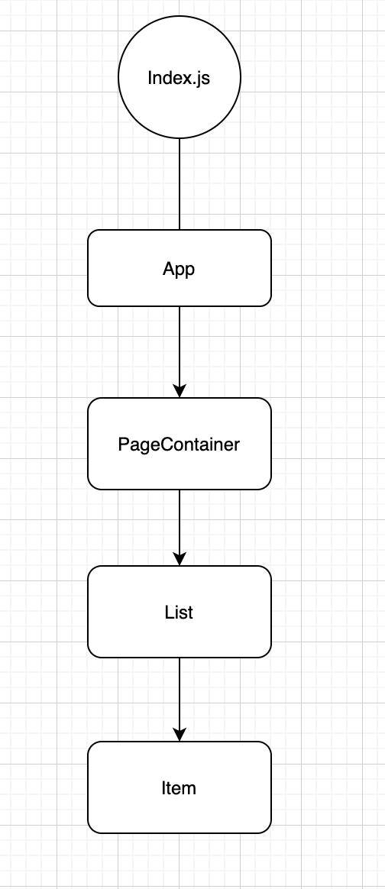
Our demo app
Today we will build a small demo getting data from an API.
We will make reuse of several areas we have already covered such as:
Promises
Map
ES6 Destructuring
Our app has the structure on the right
The index.js calls the App component
The App component calls the page.container component
The page container calls the list component
The list component calls the list-item component

Slide 5
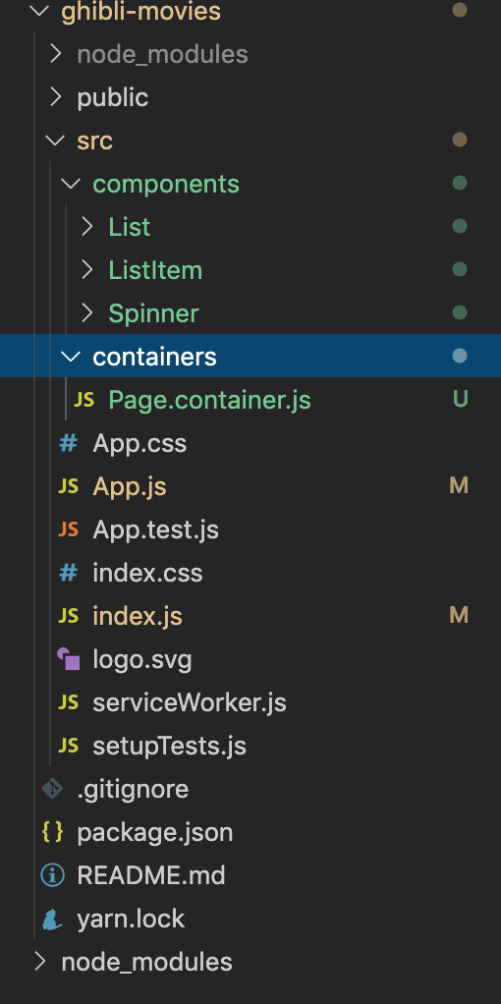
Folder structure
Similarly we have created a similar folder structure that is easily to locate the files based on the usage
Our App component is imported on index.js

Slide 6
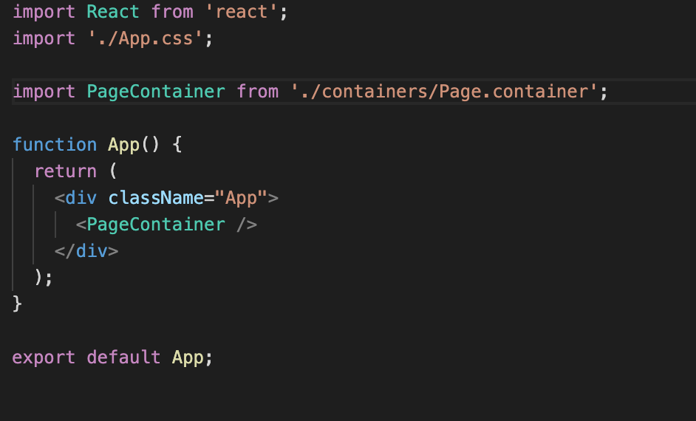
App.js
App.js is importing the Page.container
What kind of component is this? And why?

Slide 7
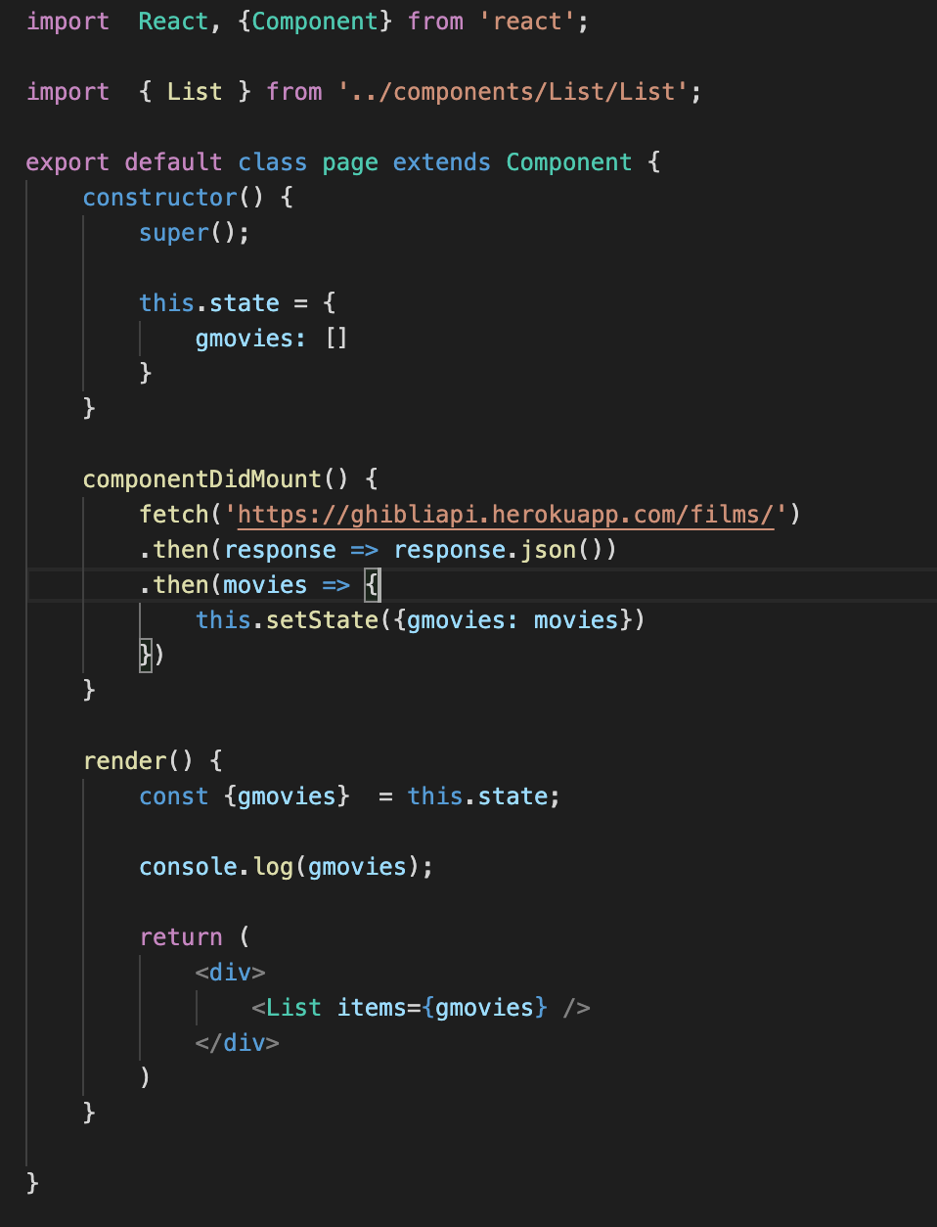
Page.container component
This component is different from the App.js in the way it is written why?
This component
Has state gmovies
Has a lifecycle method componentDidMount
A render method that loads the List component

Slide 8
Components Lifecycle
Each component has several “lifecycle methods” that you can override to run code at particular times in the process.
Methods prefixed with will are called right before something happens, and methods prefixed with did are called right after something happens.
Some of the basic ones are on the right.
For more information please visit:
https://reactjs.org/docs/react-component.html
Mounting​
constructor()​
componentWillMount()​ (DEPRACATED)
render()​
componentDidMount()​
​
Updating​
componentWillReceiveProps()​
shouldComponentUpdate()​
componentWillUpdate()​
render()​
componentDidUpdate()​

Slide 9
Exercise 1
Let's try Exercise 1 from the exercises document in Moodle.

